Slide 1
West Division
Notes:
first in sequence

Slide 2


Slide 3
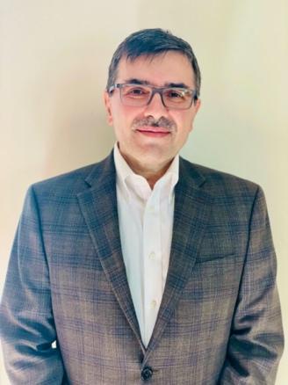
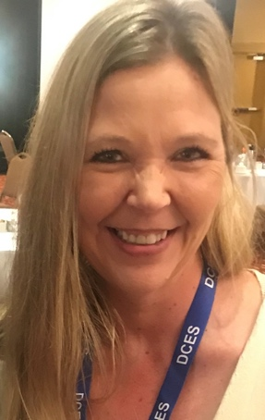
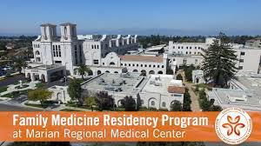
Dr. Reza Toussi
Jody Davis
Marian Family Medicine Residency Program

Slide 4


Slide 5
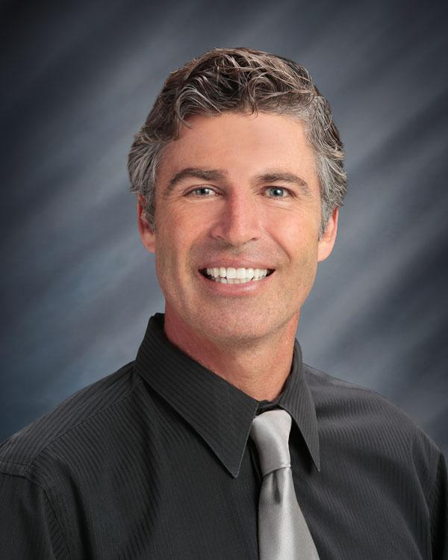
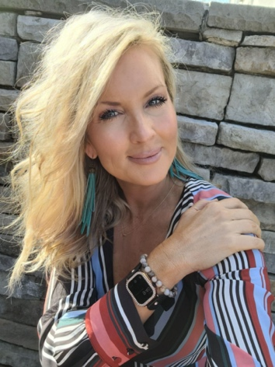
Dr. Ramsey Ulrich
Tiffany Tidwell

Slide 6


Slide 7
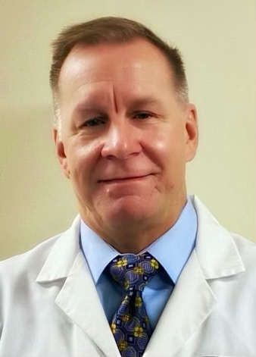
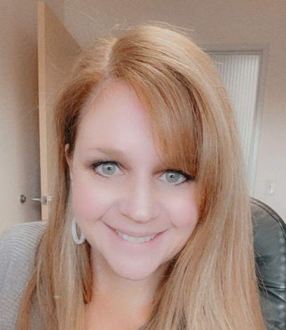
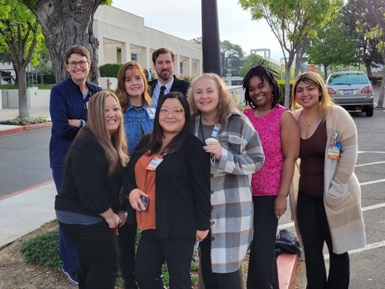
Dr. Christian Swanson
GSSA Employee Health Team
Lisa Saucedo

Slide 8


Slide 9
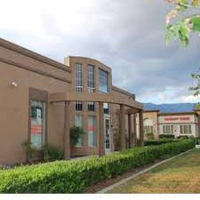
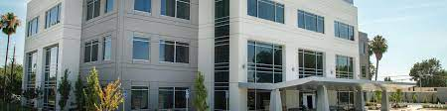
Hypertension Management
Top Performing Clinic
MMG-Citrus Heights Family Practice
Inland Empire-Fontana Pediatrics & Family Practice

Slide 10
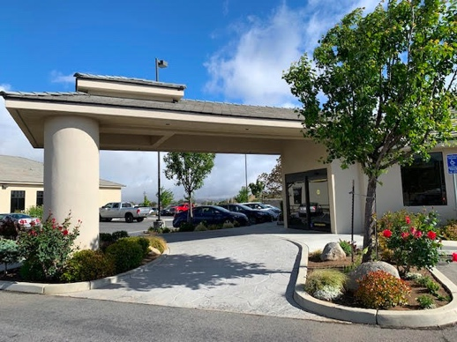
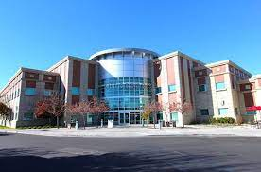
Hypertension Management
Most Improved Clinic
Tehachapi
Bakersfield - 9500 Stockdale S200

Slide 11
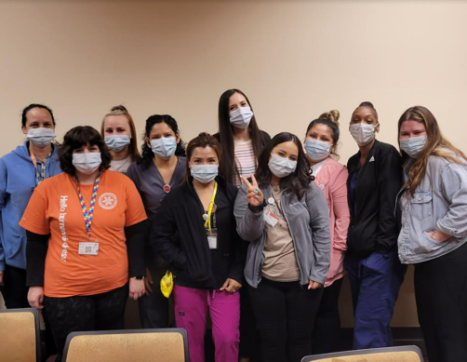
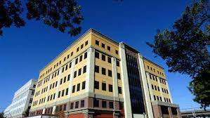
Diabetes Management
Top Performing Clinic
Mercy Medical Group - Midtown -Pediatrics/ Allergy/Geriatrics/Palliative Care and Pulmonology
Mercy Medical Group - Midtown Family Practice and Gastroenterology

Slide 12
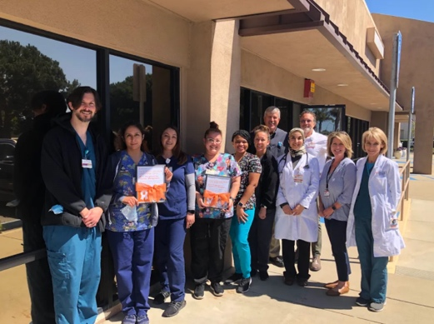
Diabetes Management
Most Improved Clinic
Lompoc Walk-in Care & Family Care
Mercy Medical Group - Midtown Family Practice and Gastroenterology

Slide 13


Slide 14
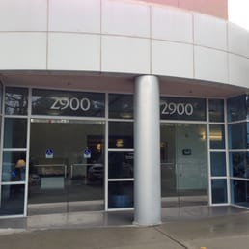

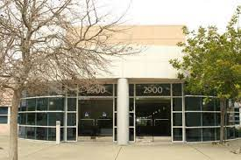
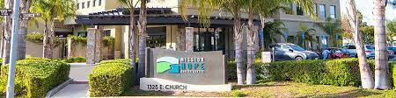
Patient Experience Awards
Best Performance Clinic Award
Dignity Health Medical Group - Dominican Family Practice (Aptos)
Dignity Health Medical Group - Sequoia Cardiology (2900 Whipple, Ste 230)
Dignity Health Medical Group - Sequoia Cardiovascular Surgery
Mission Hope Health Center

Slide 15
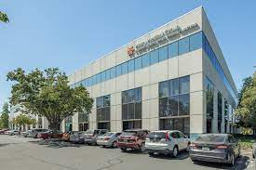

Patient Experience Awards
Most Improved Clinic Award
Dignity Health Medical Group - Dominican Family Practice (Aptos)
Mercy Medical Group - 6555 Coyle Ave - Ste 380 (Nephrology)

Slide 16
Southwest Division
Notes:
second in sequence

Slide 18
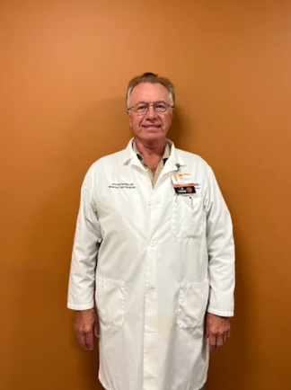
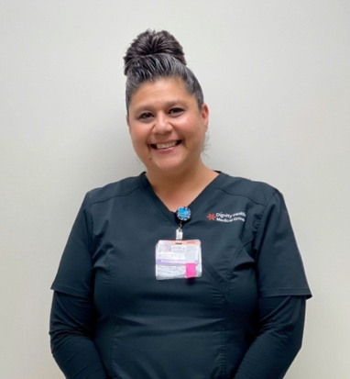
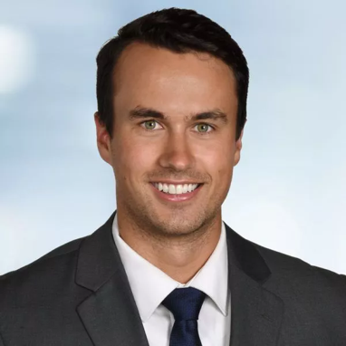
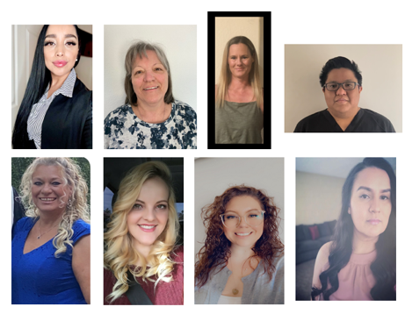
Dr. Jeffrey Ehresman
Dr. John Garbaciak
Jackie Lugo
Resource Center Team in NV Patient Connection Center (PCC)

Slide 20
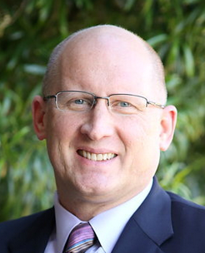

Dr. Clifford Jones
Dena Jones

Slide 22
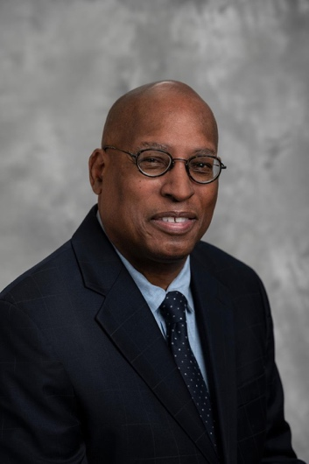
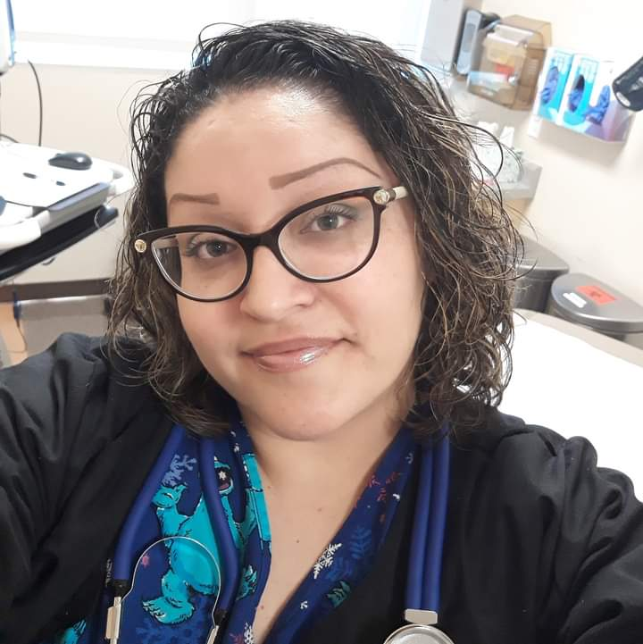
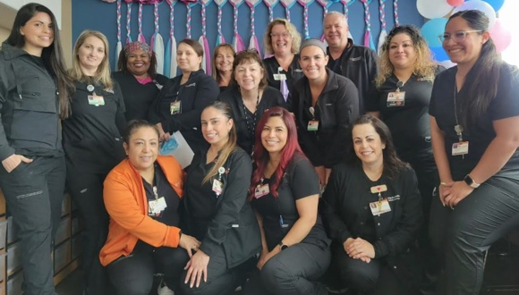
Division of Women’s Health/MFM at DHMG AZ
Dr. Miguel Pierla-Cruz
Nancy Manriquez

Slide 24
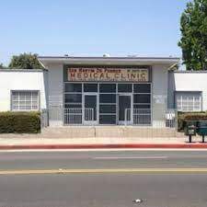
Diabetes Management
Most Improved Clinic
San Martin Clinic

Slide 26
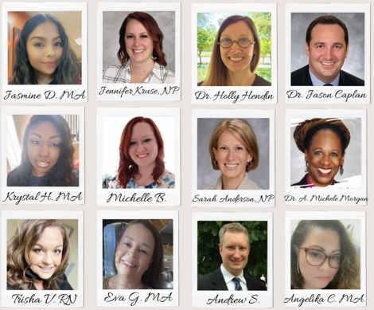

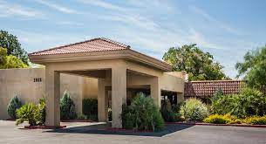
Patient Experience Awards
Best Performance Clinic Award
Behavioral Health – St. Joseph’s
St. Rose Pediatric Endocrinology Dream Fund Clinic
Transitional Care – St. Joseph’s

Slide 27
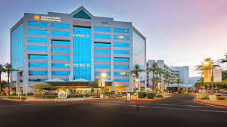
Patient Experience Awards
Most Improved Clinic Award
Maternal Fetal Medicine – St. Joseph’s
Transitional Care – St. Joseph’s

Slide 28
Southeast Division
Notes:
third in sequence

Slide 30
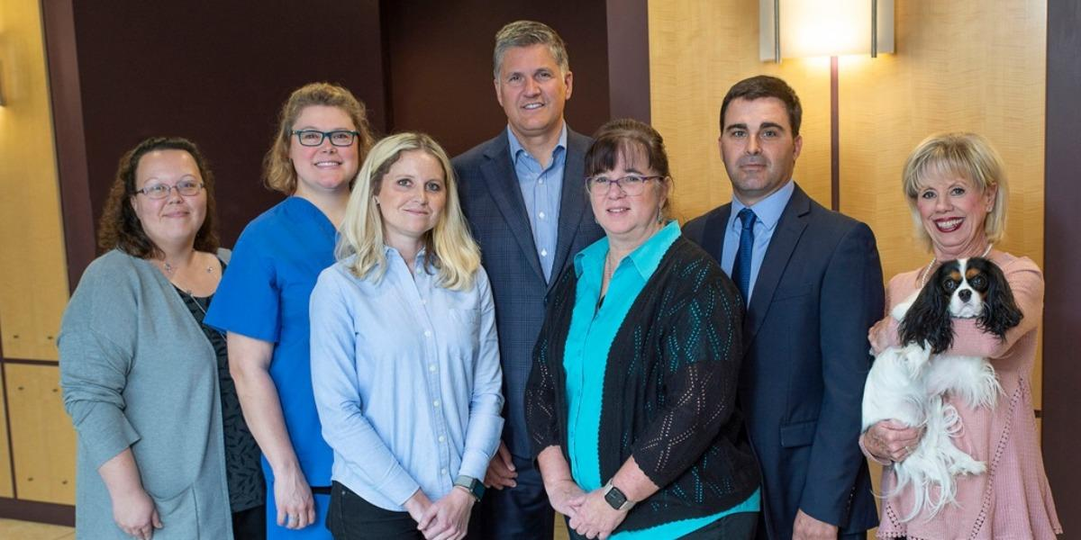

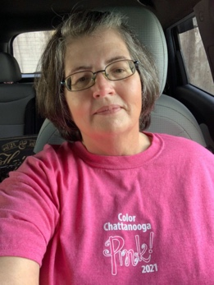
CHI Memorial Thoracic Oncology Associates
John Howell, PA
Wanda Crawford

Slide 32
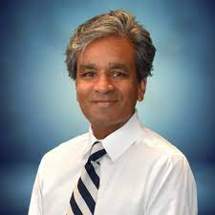
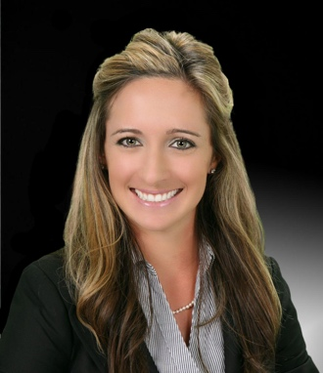

Trinity Health System Cardiovascular Service Line
Esther Mills & Jessica Stanley
Dr. Kumar Amin

Slide 34
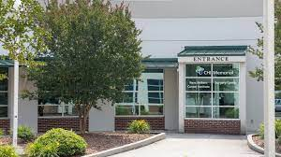
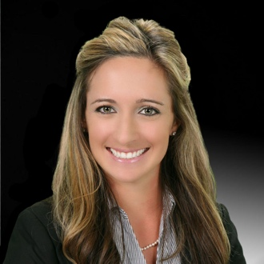
CHI Memorial Surgical Associates
Dr. Peter Emanuel
Jessica Stanley

Slide 36
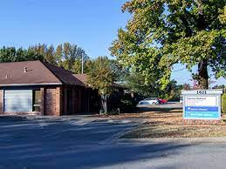
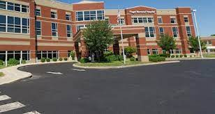
Hypertension Management
Top Performing Clinic
CHI SV Primary Care Braden
KO 1 SJ Primary Care Associates Coburn

Slide 37
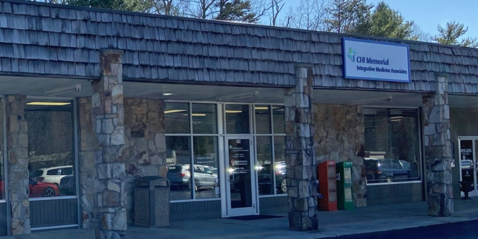
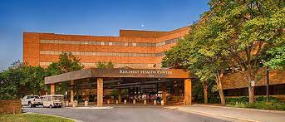
Hypertension Management
Most Improved Clinic
CHI Memorial Associates Internal Medicine Associates - Signal Mountain
KO 3 SJ Internal Medicine Asc Long

Slide 38
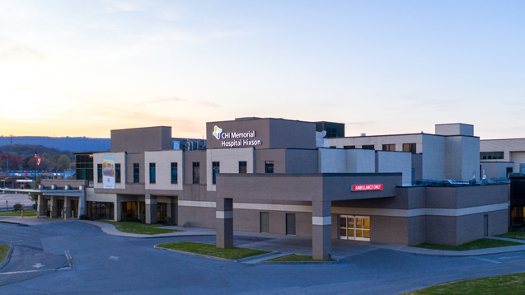
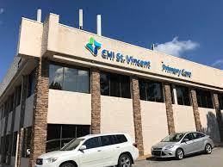
Diabetes Management
Top Performing Clinic
CHI Memorial Associates Internal Medicine Associates - Chattanooga, Hixson Pike
CHI SV Primary Care Scott

Slide 39
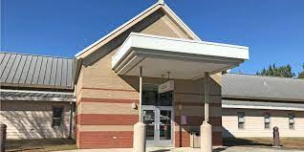
Diabetes Management
Most Improved Clinic
CHI Memorial Internal Medicine Associates - Signal Mountain
CHI Memorial Family Practice Associates - Lafayette

Slide 41
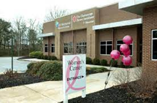

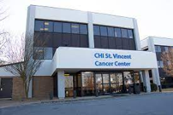
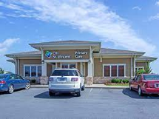
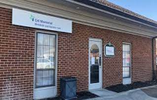

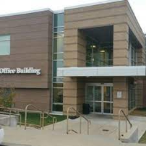
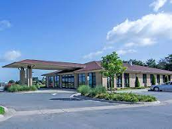

Patient Experience Awards
Best Performance Clinic Award
CHI Memorial Breast Care Associates
CHI Saint Joseph Medical Group - Primary Care (New Haven)
CHI St. Vincent Oncology Cancer Center
CHI Memorial Metabolic and Bariatric Care
CHI Saint Joseph Medical Group - Primary Care (Mt. Sterling, 40 S Bank St)
CHI St. Vincent Primary Care - Lonoke
CHI Memorial Primary Care Associates - Cleveland
CHI Saint Joseph Medical Group - Primary Care (Mt. Sterling, 227 Falcon Dr)
CHI St. Vincent Primary Care - Scott

Slide 42



Patient Experience Awards
Best Performance Clinic Award
CHI St. Vincent Urogynecology Clinic
Trinity Health System - Orthopedics & Sports Medicine
Trinity Family Care Center - Multispecialty Physical Medicine and Rehab
Trinity Health System - Primary Care
Trinity Family Care Center - Ross Park (Pediatrics)
Trinity Medical Group Specialty Clinic

Slide 43


Patient Experience Awards
Most Improved Clinic Award
CHI Saint Joseph Medical Group - Primary Care (Richmond)
CHI Saint Joseph Medical Group - Urology

Slide 44


Slide 45

Chris Lowney
Vice Chair, Board of Directors
CommonSpirit Health

Slide 46

Lloyd H. Dean
Chief Executive Officer
CommonSpirit Health

Slide 48
Texas Division
Notes:
fourth in sequence

Slide 50

Shalonda Hayter

Slide 52

Kendyl Parker

Slide 54



Baylor St. Luke’s Medical Center Lung Transplant Team
Dr. Paul McNeely
Dr. Clint Cheng

Slide 56


Hypertension Management
Top Performing Clinic
BSLMG Agape Physicians (Primary Care/Pediatric – Woodlands)
Brazosport Oak Drive Family Medicine

Slide 57


Hypertension Management
Most Improved Clinic
Memorial Clinics Livingston Multispecialty Center
Memorial Clinics Angelina Internal Medicine

Slide 58

Diabetes Management
Top Performing Clinic
BSLMG Agape Physicians (Primary Care/Pediatric – Woodlands)
St. Joseph Normangee Family Medicine

Slide 59

Diabetes Management
Most Improved Clinic
BSLMG Agape Physicians (Primary Care/Pediatric – Woodlands)

Slide 61







Patient Experience Awards
Best Performance Clinic Award
BSLMG Oglesbee Family Clinic
SJMG General Surgery Associates - Rock Prairie
SJMG Primary Care - Hearne
BSLMG Woodlands Bridge Clinic
SJMG Orthopaedic Associates
SJMG General Surgery Associates - GBSA
SJMG Pediatrics - Bryan

Slide 62


Patient Experience Awards
Most Improved Clinic Award
BSLMG Multispecialty Clinic MAC II (Endocrinology and Diabetes)
BSLMG Multispecialty Clinic Springwoods Village (Orthopedics)

Slide 63
Midwest Division
Notes:
fifth in sequence

Slide 65


April Morrow
CHI University Campus Clinic

Slide 67



CHI St. Alexius Health Williston – Primary Care Walk-in Clinic
Dr. Aaron Robinson
Shelli Hayes

Slide 69



Dr. Ronn Johnson
Dr. Muhammed Shittu
Oakes Family Clinic

Slide 71


Hypertension Management
Top Performing Clinic
Dunlap Family Medicine
Nebraska City Family

Slide 72


Hypertension Management
Most Improved Clinic
Clarkson Family Medicine
Family Health Physicians (now CHI Health 70th and A)

Slide 73


Diabetes Management
Top Performing Clinic
CHI St. Alexius Health Mandan Medical Plaza FAM MED
Lakeside Family Medicine

Slide 74


Diabetes Management
Most Improved Clinic
Oakland Family Medicine
West Broadway Family Clinic

Slide 76









Patient Experience
Best Performance Clinic
Beach Family
CHI Health Clinic (Stevens Creek)
CHI Health Orthopedics (161st W Maple)
CHI Health Clinic Direct Primary Care (132nd & Center)
CHI Health Clinic MD VIP (Lakeside)
CHI St. Alexius Health Garrison Family Clinic
CHI Health Nebraska Heart Institute (NHI) Columbus
CHI Health Clinic Foot and Ankle (Council Bluffs)
CHI Lisbon Health

Slide 77


Patient Experience
Most Improved Clinic
CHI Health Nebraska Heart Institute (NHI) Columbus
CHI Health Clinic Neurology (CUMC Bergan)

Slide 78
Pacific Northwest Division
Notes:
sixth in sequence

Slide 80



Luzmarina Tejada, MN, CCM, PHN, RN & Dr. Jude Gerard Verzosa
Jocelyn Thomas, ARNP
Tanala Weaver

Slide 82



Dr. Jessica Schlicher
Tina Tyrell & Dr. Jude Gerard Verzosa
Michael T. Anderson

Slide 84


Dr. Jason Gray
Dr. Jude Gerard Verzosa

Slide 86


Hypertension Management
Top Performing Clinic
VMFH Bainbridge
VMFH Belfair

Slide 87

Hypertension Management
Most Improved Clinic
VMFH Bainbridge
VMFH
Canyon Road

Slide 88


Diabetes Management
Top Performing Clinic
VMFH Burien
VMFH Peninsula Internal Medicine and Rheumatology

Slide 89


Diabetes Management
Most Improved Clinic
VMFH
Gig Harbor
VMFH St. Joseph

Slide 91






Patient Experience Awards
Best Performance Clinic Award
Centennial Umpqua Valley Eye Associates
VMFH Gynecologic Oncology Associates at St. Anthony
VMFH Breast Care & General Surgery – Silverdale
VMFH Gynecologic Oncology Associates at St. Joseph
VMFH Cardiothoracic Surgery Associates at St. Joseph
VMFH Plastic Surgery Associates at St. Anthony

Slide 92


Patient Experience Awards
Most Improved Clinic Award
VMFH Cardiovascular Consultants, Satellite – Poulsbo
VMFH Orthopedic Associates – Burien

Slide 93
System Employees

Slide 95


DHMSO's Clinical Care Services Group
Dr. Gary Greensweig

Slide 97


Jessica Dixon
Physician Enterprise Transformation Team

Slide 99


John Kniesche
Physician Enterprise Coding - Texas

Slide 101
Overall Winners

Slide 103

Wanda Crawford

Slide 104

John Garbaciak

Slide 105


LuzMarina Tejada MN, CCM, PHN, RN & Dr. Jude Gerard D. Verzosa, MD

Slide 107
Nancy Manriquez

Slide 108

Oakes Family Clinic

Slide 109

Paul McNeely

Slide 111
Kendyl Parker

Slide 112

PE Transformation Team

Slide 113
Ramsey Ulrich

Slide 115

Texas Division

Slide 116
Texas
“
[My] Provider is caring compassionate and takes the time to answer all questions.
Absolutely love the doctors and the nurses always feel at ease with them.
Amazing customer service, everyone made me feel so welcome. Thank you to the doctor for his kind words and for making me feel very comfortable with myself.
Everyone worked together as a team. Great approach to my wellness. Clinic was spotless. Everyone I met was helpful.
From Our Texas Patients
”

Slide 117

Southeast Division

Slide 118
Southeast
“
I have already begun referring others to this practice because of the level of care I have received thus far.
The doctor and his nurse are always very caring and professional.
[They are] very attentive and listens to my concerns. Seems to care about what my thoughts are about my involvement in my treatment.
I love the staff. They treat me like a friend or family instead of a patient. The doctor is the best I have ever been to. He listens and makes me feel at ease.
From Our Southeast Patients
”

Slide 120
Hypertension Management
Top Performing Clinic • Large Clinic +1,000 patients
Southeast
CHI St. Vincent Primary Care - Braden

Slide 121

Hypertension Management
Top Performing Clinic • Small Clinic =<1,000 patients
Southwest
Baylor St. Luke's Medical Group Agape Physicians (Primary Care/Pediatric - Woodlands)

Slide 122
Hypertension Management
Most Improved Clinic • Large Clinic +1,000 patients
Southwest
Memorial Clinics Angelina Internal Medicine

Slide 123

Hypertension Management
Most Improved Clinic • Small Clinic =<1,000 patients
Southeast
CHI Memorial Internal Medicine Associates - Signal Mountain

Slide 124

Diabetes Management
Top Performing Clinic • Large Clinic +500 patients
Southwest
Baylor St. Luke's Medical Group Agape Physicians (Primary Care/Pediatric - Woodlands)

Slide 125

Diabetes Management
Top Performing Clinic • Small Clinic =<500 patients
West
Mercy Medical Group - Midtown Pediatrics/Allergy/ Geriatrics/Palliative Care and Pulmonology

Slide 126

Diabetes Management
Most Improved Clinic • Large Clinic +500 patients
Pacific Northwest
VMFH St. Joseph

Slide 127

Diabetes Management
Most Improved Clinic • Small Clinic =<500 patients
West
Lompoc Walk-In Care & Family Care

Slide 128


Slide 129
Judging Criteria
Please utilize the Likert Scale to provide feedback on the publication
Likert Scale: 1 to 4 ( 4 = To a Great Extent • Somewhat • Very Little • 1 = Not at All )
Direct Clinical Care: The publication addresses an important question or problem that is directly related to clinical care delivery
*Generalizability: The publication offers concepts or theories that are generalizable or transferable to other contexts, people, etc.
*Generalizability: The publication has generalizability because of the selection of participants, setting, and educational intervention or materials.
*Research design: The publication’s research methods are defined and clearly described, and they are sufficiently detailed to provide transparency or permit the study to be replicated.
*High impact: The publication’s practical significance or theoretical implications are discussed; guidance for future studies is offered.
Influencer status: Will this publication provide guidance that will influence care delivery for large segments of the population?
*Based on the AAMC Review Criteria for Research Manuscripts

Slide 130
Panel of judges
Vani Nilakantan, PhD System Vice President Research at CommonSpirit Health Research Institute
Ankita Sagar, MD, MPH, FACP System Vice President for Clinical Standards and Variation Reduction, Physician Enterprise
Corey Karlin-Zysman, MD, SFHM, FACP, System Senior Vice President, Physician Enterprise, Southwest Division
Randy Pritza MD, MMM, VP - Chief Medical Officer, CHI Health Physician Enterprise
Mark Heinsohn, MD, Internal Medicine, Chattanooga, TN

Slide 131



Academic Excellence: Academic Institution Award
Baylor College of Medicine
Corresponding Author - Richard Gibbs, PhD
Contributing Author - Christie Ballantyne, MD

Slide 132


Academic Excellence: Academic Institution Award
Baylor College of Medicine
Lead Author - Hana M. El Sahly, MD

Slide 133


Academic Excellence: Academic Institution Award
Creighton University School of Medicine
Corresponding Author - Srinagesh Mannekote Thippaiah, MD

Slide 134



Academic Excellence: Academic Institution Award
Morehouse School of Medicine
Principal Investigators - Herman A Taylor, MD & Peter Baltrus, PhD and Team

Slide 135



Academic Excellence: Academic Institution Award
Morehouse School of Medicine
Lead Author - Obiora Egbuche, MD Corresponding Author - Melvin R. Echols, MD

Slide 136


Academic Excellence: Community Award
CHI Memorial Stroke and Neuroscience
Contributing Author: Thomas Devlin, MD

Slide 137


Academic Excellence: Community Award
Mercy General Hospital and Dignity Health Heart and Vascular Institute
Lead Author - Arash Aryana, MD

Slide 138


Academic Excellence: CommonSpirit Health Mission Award
Dignity Health Methodist Hospital
Lead Author - Ron Chambers, MD

Slide 139
Academic Excellence: Academic Institution Award & Overall Winner
Baylor College of Medicine
Corresponding Author - Richard Gibbs, PhD
Contributing Author - Christie Ballantyne, MD

